Slide 1


TRiCAM QRI Project Presentation
Understanding the Behavior of Oil Wells through Deep Learning
Presentation 1
Presenter: Akash Levy
This presentation: project description, preprocessing, what’s next
Appendix: how deep learning works
Project Members: Michelle Yang, Akash Levy, Janette Garcia, Albert Tung

Slide 2
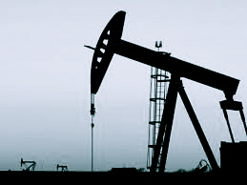
Introduction & Problem Statement
Project proposed by Quantum Reservoir Impact (QRI)
QRI: petroleum reservoir management company
Project goal: identify features in production data and forecast oil production rate in petroleum wells
Task 1: detect “events” (repairs, upgrades, other modifications to a well) = data mining
Task 2: forecast oil production rate with relative accuracy = machine learning
Strategy: use deep learning

Slide 3
Classical Prediction using Hard-coded Regression Modeling
Oil production (in standard barrels) vs. Year
Event detection (anonymized data)

Slide 4
Classical Prediction using Hard-coded Regression Modeling
Oil production (in standard barrels) vs. Year
Linear regressions for events, exponential decay otherwise

Slide 5

Problems with Hard-coded Modeling
Must be manually developed
Human bias/error involved
Not easily adaptable
Generally less scalable for larger data sets
Use machine learning instead!
Notes:
Make a checklist, one slide showing each different model

Slide 6

deep learning?
What is it?
How does it work?
Why would we want to use it?

Slide 7
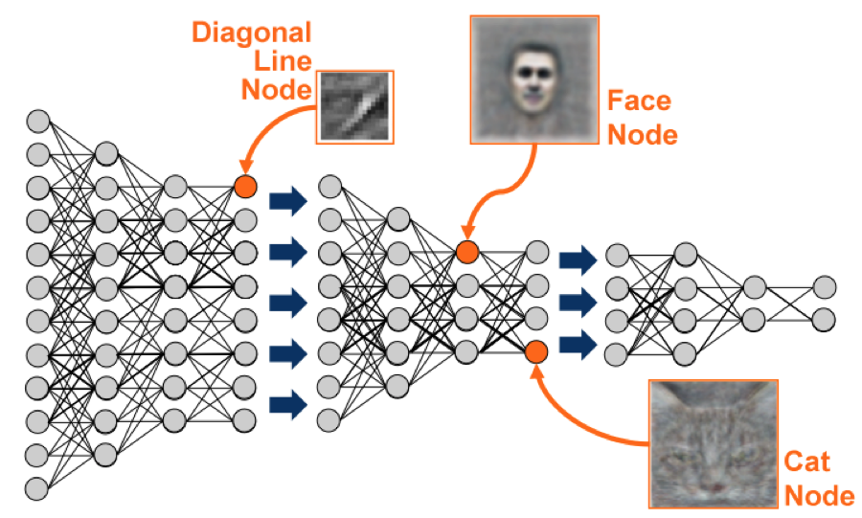
What is deep learning?
Deep learning:
Is a sophisticated form of machine learning
Applications include:
Speech recognition
Natural language processing
Stock market forecasting
Image recognition
(Google’s machine learning algorithm recognizes faces when applied to YouTube videos)

Slide 8
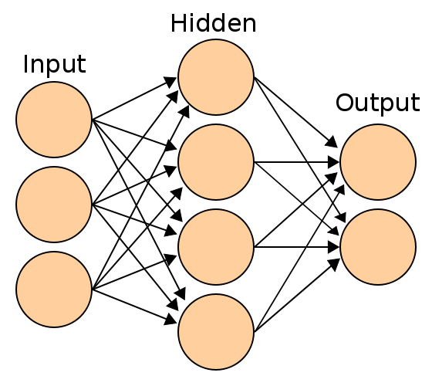
How does deep learning Work?
Deep learning involves the use of a neural network
Simple neural network layout:
Deep learning looks like this but consists of multiple hidden layers

Slide 9
Why use deep learning?
Deep Learning
Performance
Most ML algorithms
Amount of data
Notes:
Works well with larger data sets!

Slide 10
Implementations Explored
Theano: Python toolkit for running computations quickly on GPUs
Scikit-learn: Python library for machine learning
Pylearn2: Python library for machine learning (buggy, still in active development)
NuPIC (Numenta Platform for Intelligent Computing): Python library implementing HTM deep learning algorithm developed by Numenta
More on Theano in future presentations!

Slide 11
Deep Learning Architectures
Implementation:
Many, many different kinds of implementations
We have decided to use Theano and are learning the basics of it currently
We will be focusing on:
Autoencoders - Janette
Restricted Boltzmann Machines (RBMs) - Albert
Convolutional Neural Networks (CNNs) - Akash
Recurrent Neural Networks (RNNs) - Michelle
More on these implementations in future presentations!
If time permits:
Hierarchical Temporal Memory (HTM)

Slide 12
Preprocessing
What sort of preprocessing might be necessary for optimal machine learning performance?
Many problems with the data:
Missing data
Noise
Different scaling
Different time windows
Potential solutions:
Remove zeros and interpolate
Smooth data
Remove outliers
Scale data during training
Remove data sets with too small time windows

Slide 13
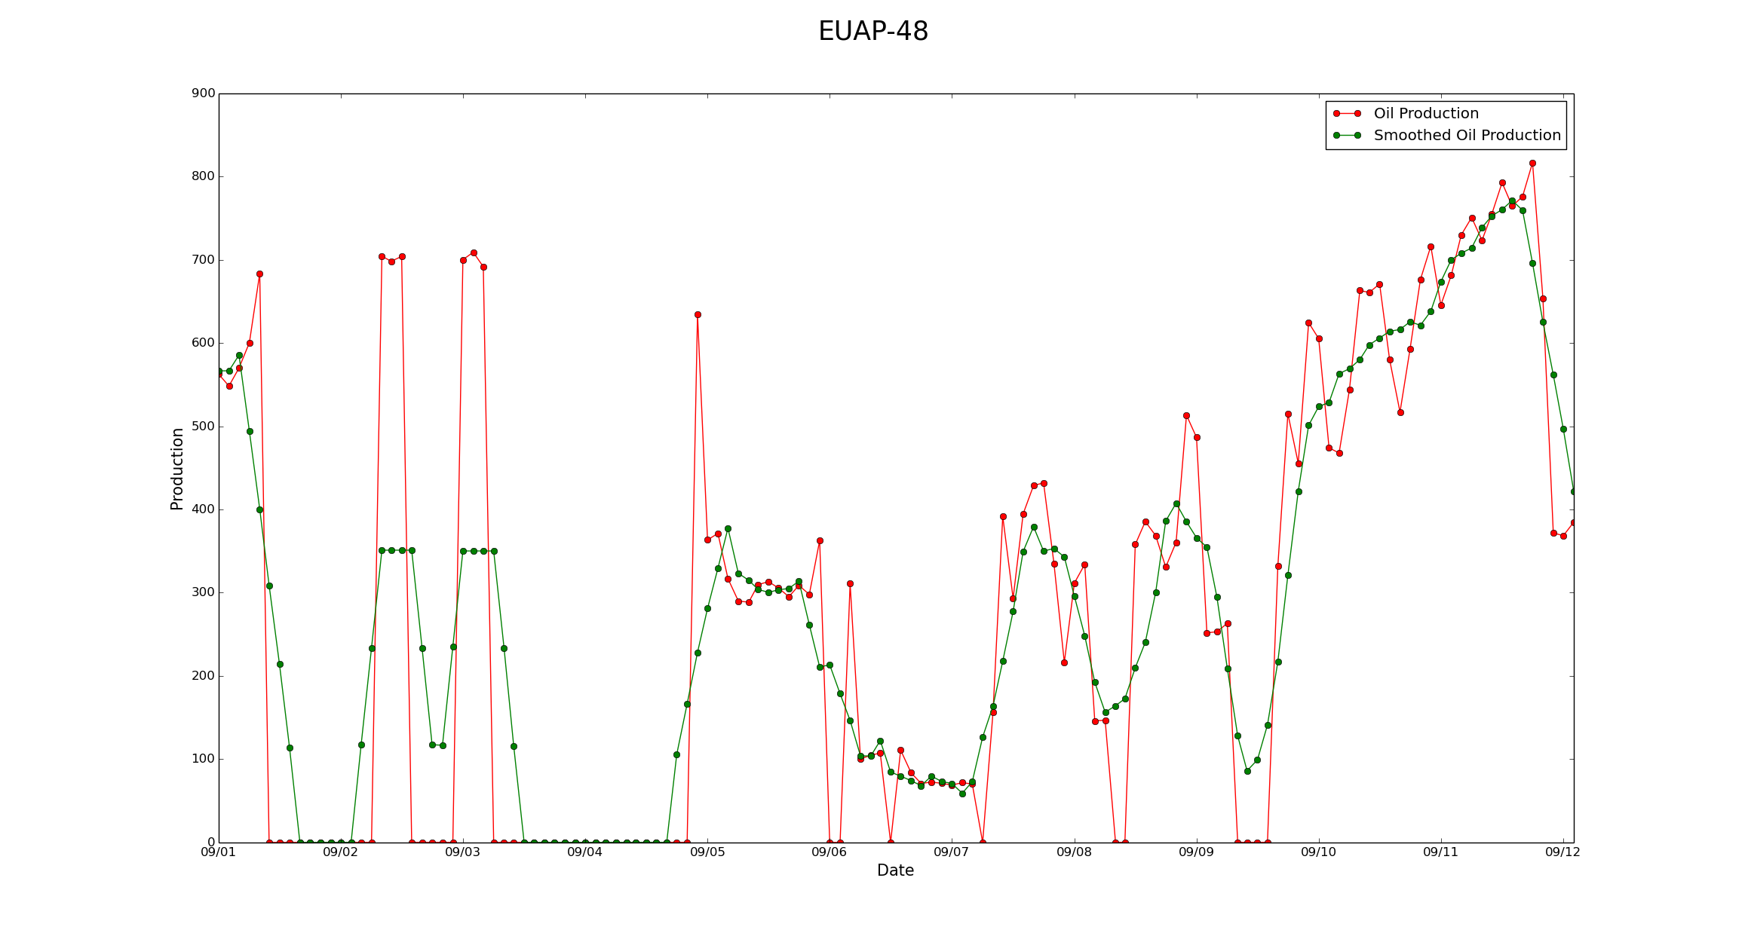
Is removing zeros appropriate?

Slide 14
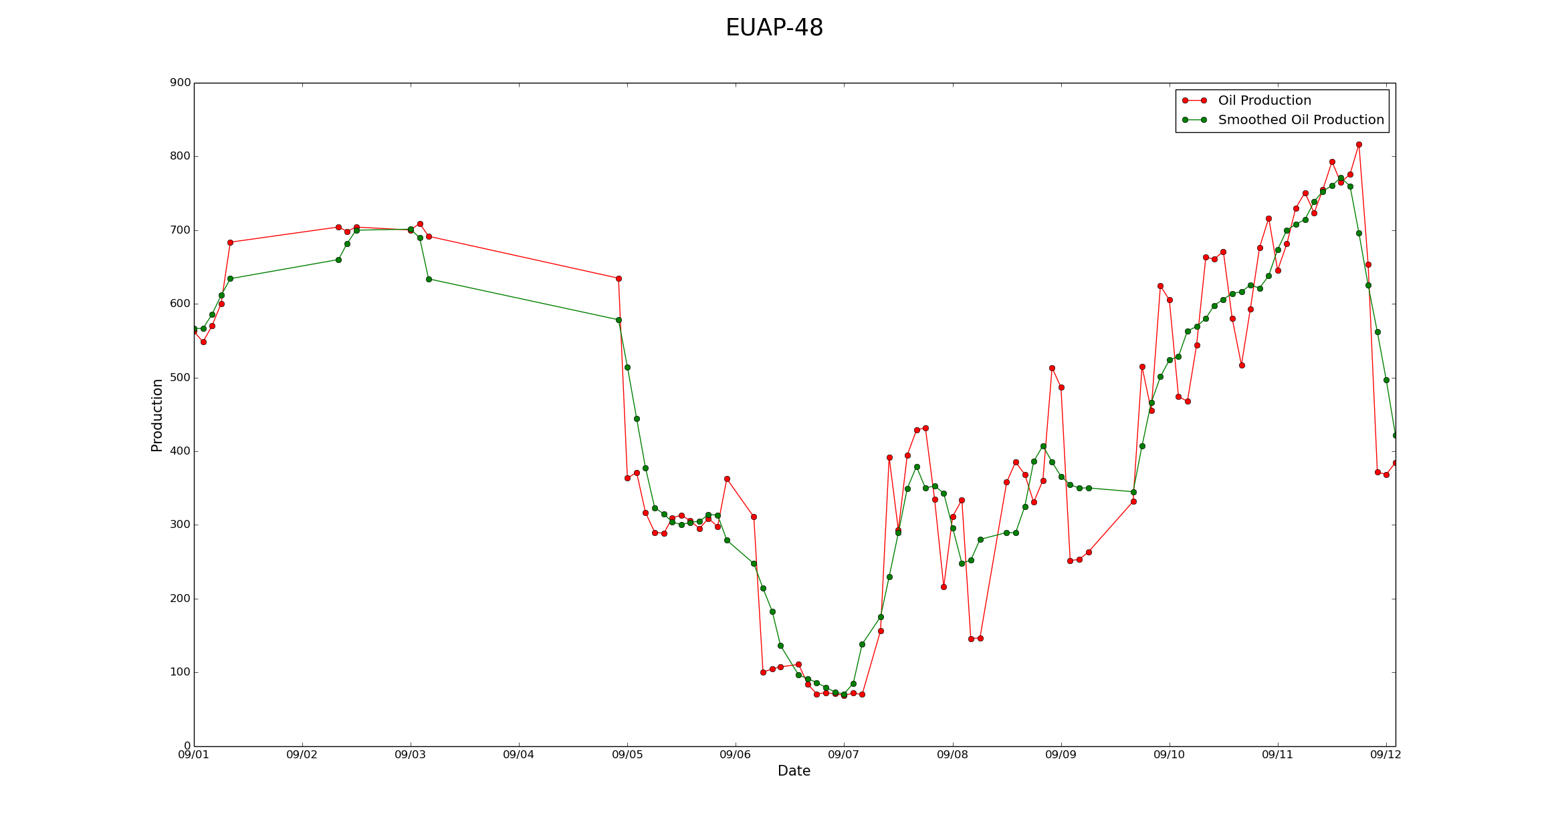
Is removing zeros appropriate?

Slide 15
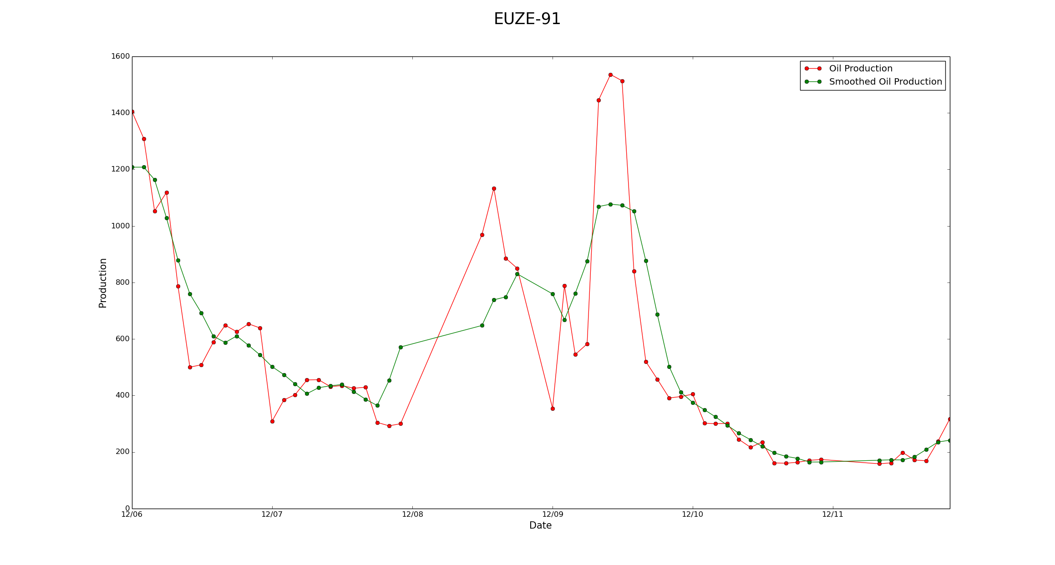
Is smoothing appropriate?

Slide 16
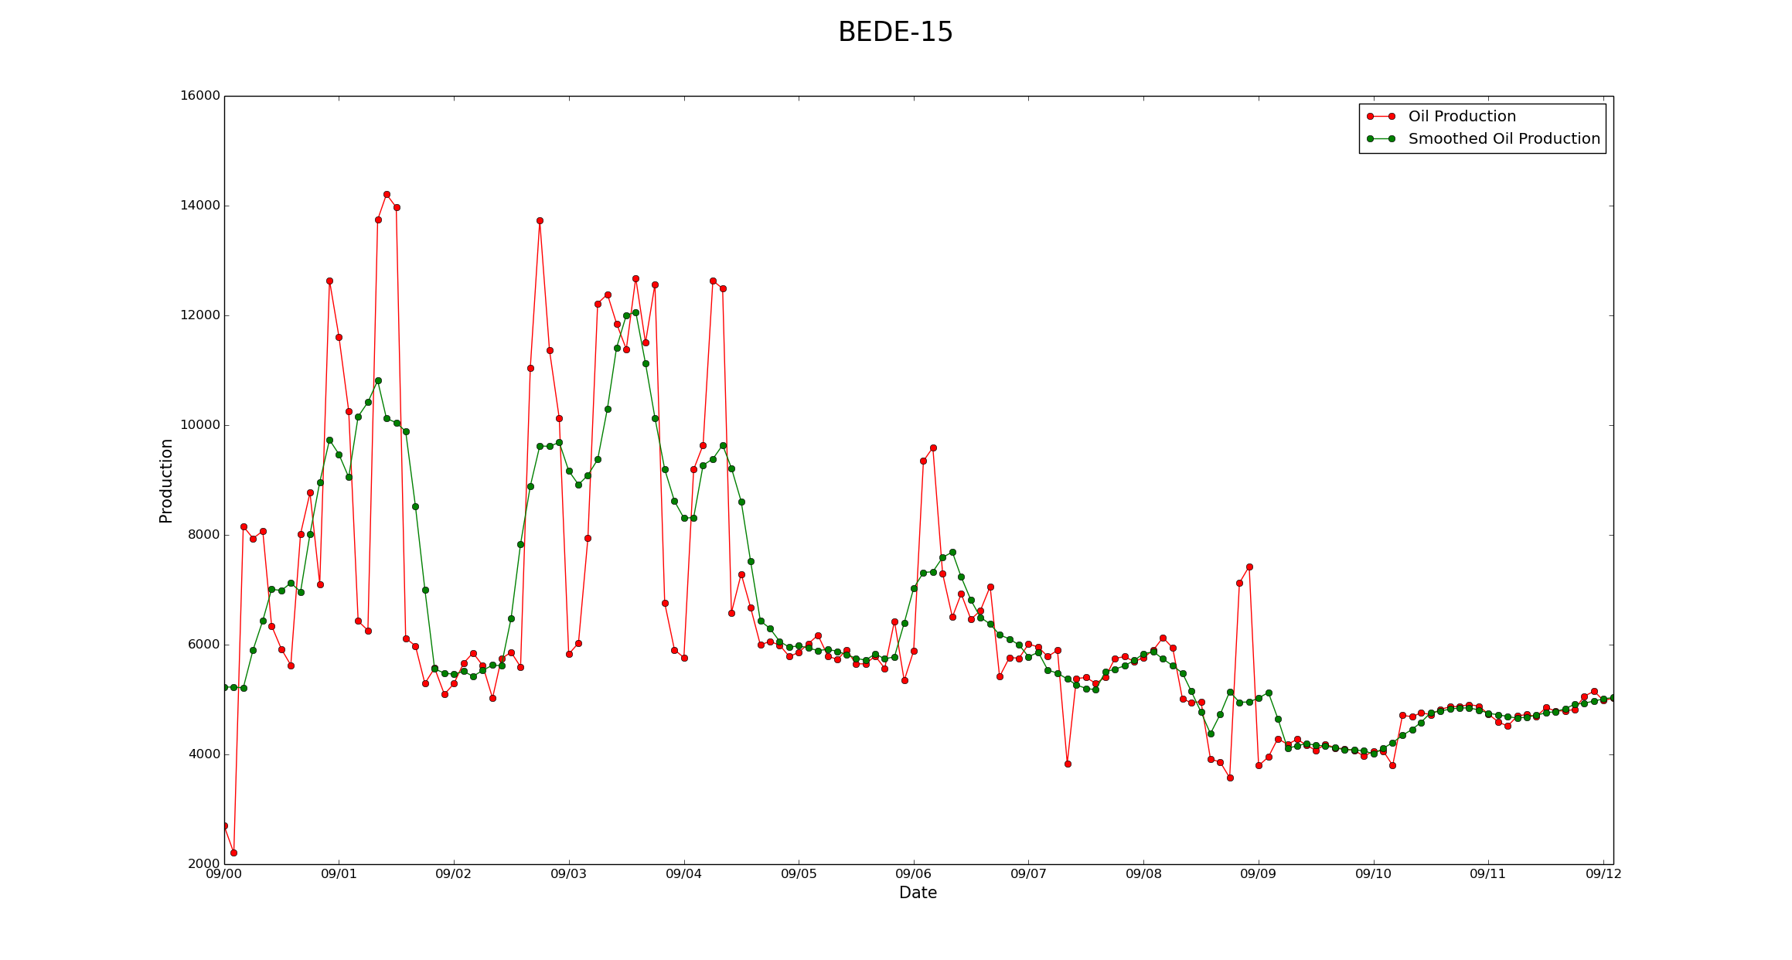
Is smoothing appropriate?

Slide 17
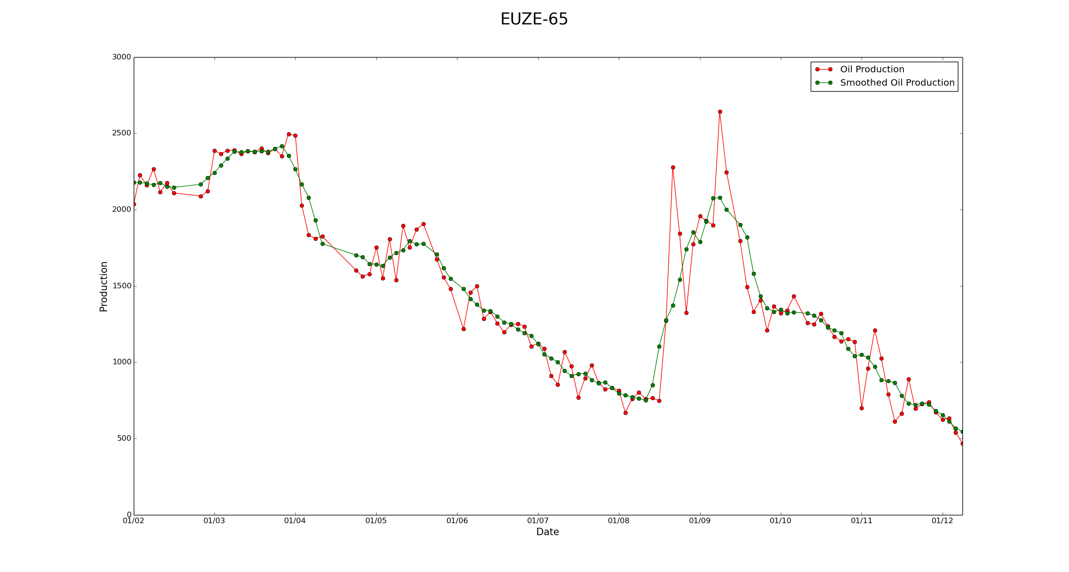
Is smoothing appropriate?

Slide 18
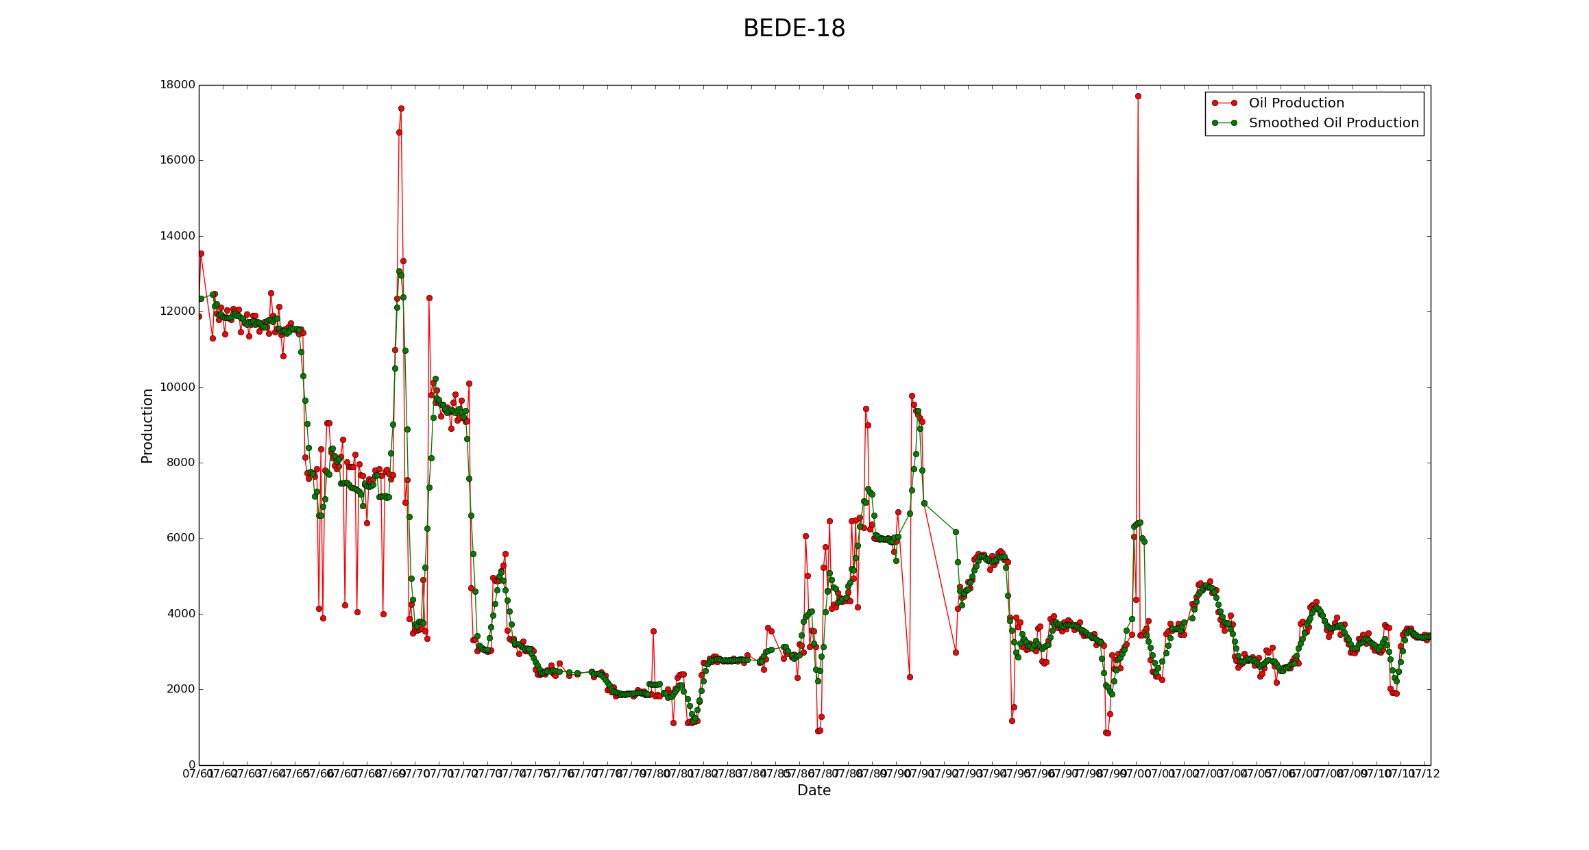
Is Outlier Removal Appropriate?

Slide 19
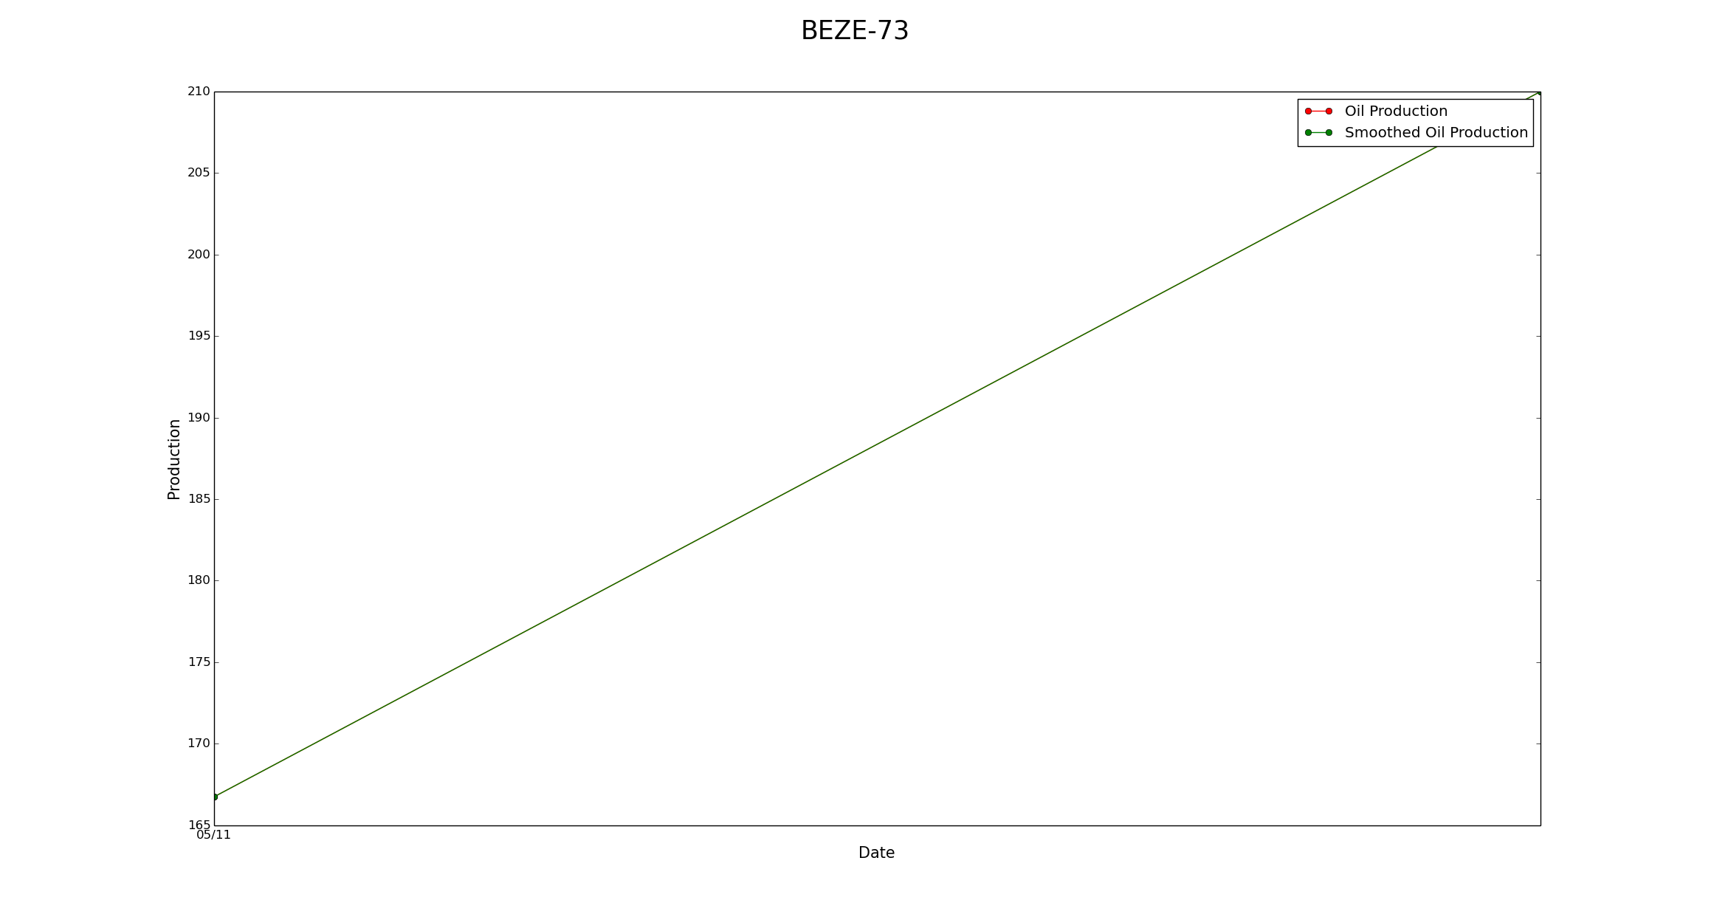
Is Removing Data Sets Appropriate?

Slide 20
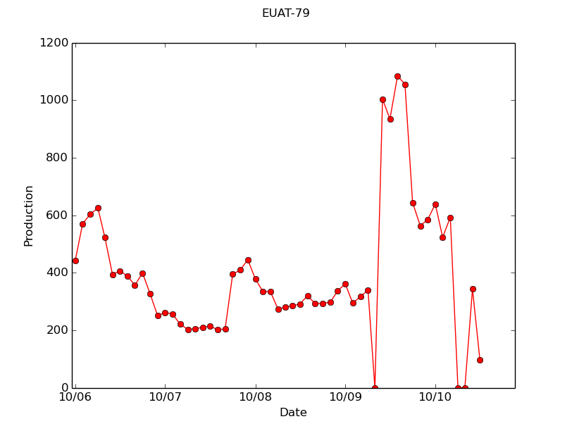
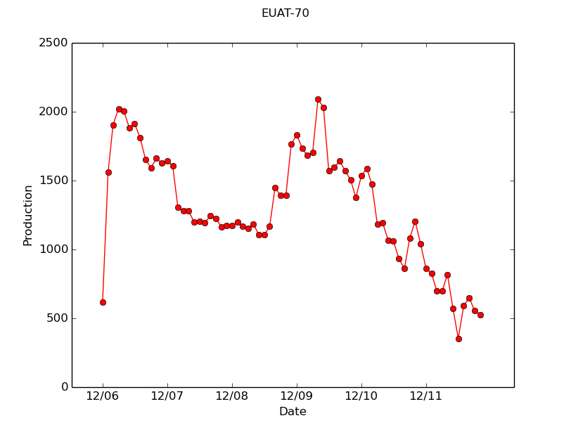
Scaling?

Slide 21
Next Time:
Thank you!
Questions?
More on specific implementations of deep learning
More on Theano

Slide 22
How does deep learning Work?
Inputs
Weight
Sum
Activation Func.
Output
I₀
w₀
I₁
w₁
∑
σ(x)
O₀
A single neuron in a neural network:
w₂
I₂
Goal: adjust the weights to get as close as possible to the expected output
This is essentially the mathematical model of learning
Construction of representational model of information
Notes:
Explain each component

Slide 23
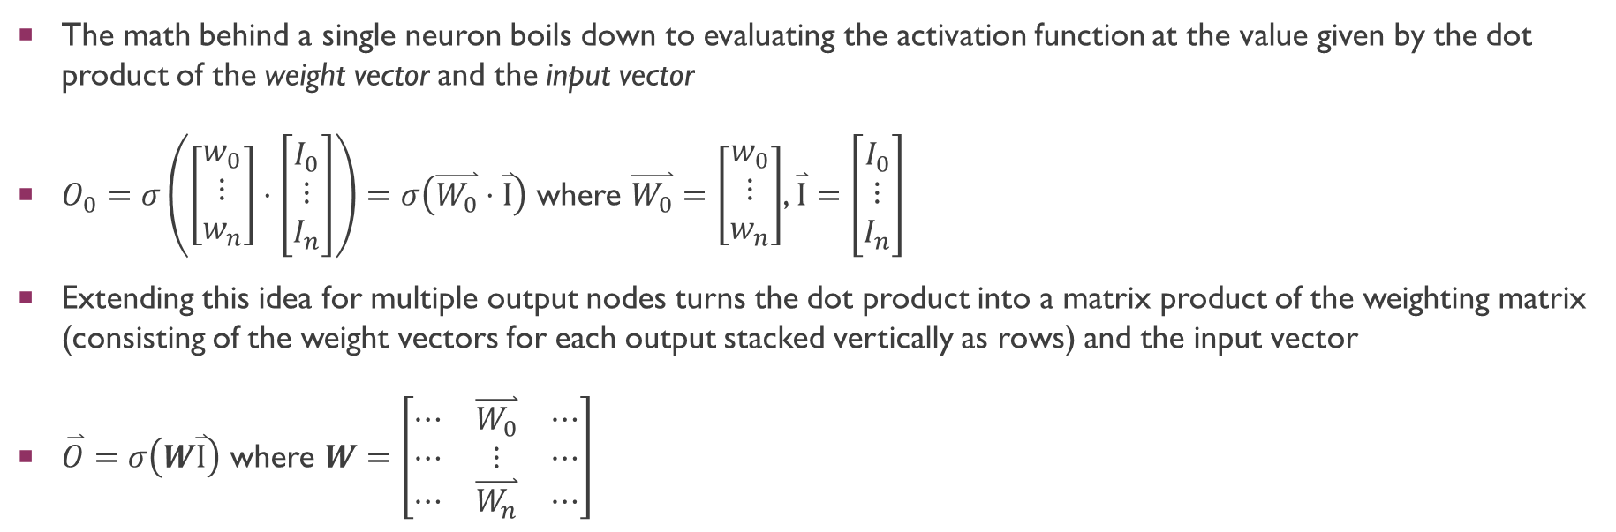
How does deep learning Work?
The math behind a single neuron boils down to evaluating the activation function at the value given by the dot product of the weight vector and the input vector
$O_{0}=σ\left(\left[\begin{matrix}w_{0} \\ ⋮ \\ w_{n}\end{matrix}\right]⋅\left[\begin{matrix}I_{0} \\ ⋮ \\ I_{n}\end{matrix}\right]\right)=σ\left(\overset{⃑}{W_{0}}⋅\overset{⃑}{I}\right)$ where $\overset{⃑}{W_{0}}=\left[\begin{matrix}w_{0} \\ ⋮ \\ w_{n}\end{matrix}\right]$, $\overset{⃑}{I}=\left[\begin{matrix}I_{0} \\ ⋮ \\ I_{n}\end{matrix}\right]$
Extending this idea for multiple output nodes turns the dot product into a matrix product of the weighting matrix (consisting of the weight vectors for each output stacked vertically as rows) and the input vector
$\overset{⃑}{O}=σ\left(W\overset{⃑}{I}\right)$ where $W=\left[\begin{matrix}⋯ & \overset{⃑}{W_{0}} & ⋯ \\ ⋯ & ⋮ & ⋯ \\ ⋯ & \overset{⃑}{W_{n}} & ⋯\end{matrix}\right]$

Slide 24
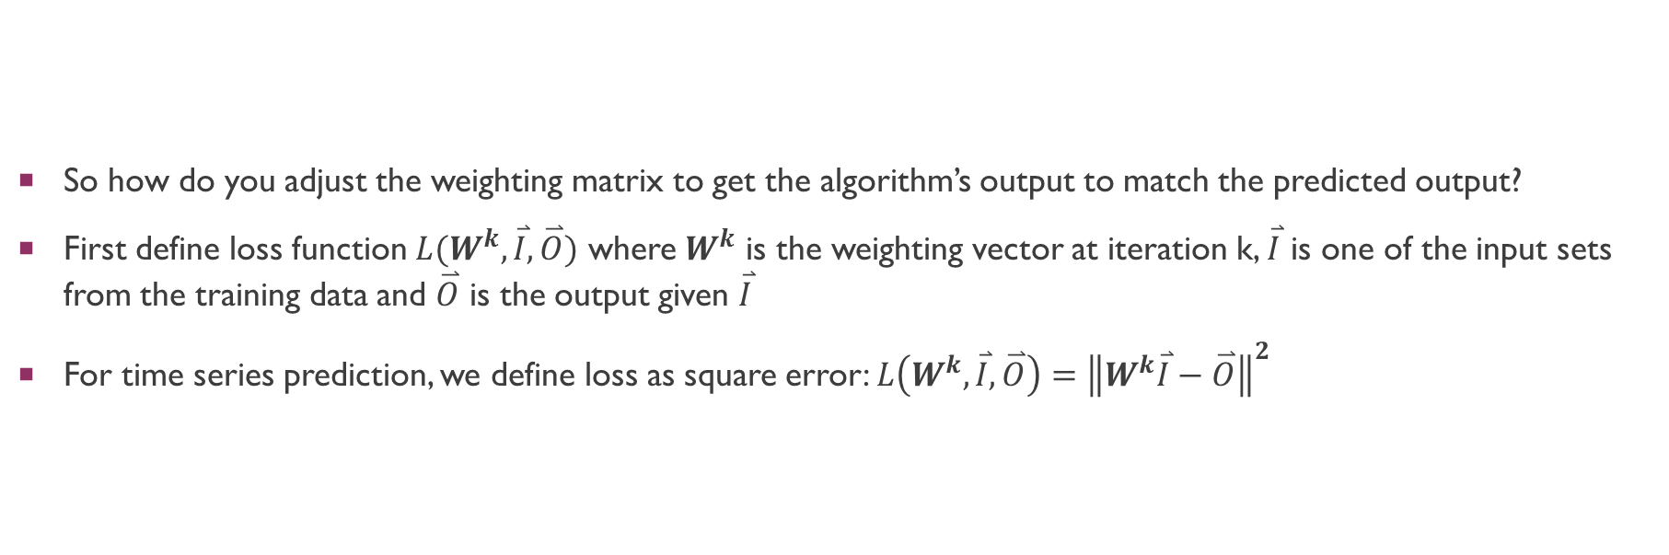
How does Deep Learning Work?
So how do you adjust the weighting matrix to get the algorithm’s output to match the predicted output?
First define loss function $L(W^{k},\overset{⃑}{I},\overset{⃑}{O})$ where $W^{k}$ is the weighting vector at iteration k, $\overset{⃑}{I}$ is one of the input sets from the training data and $\overset{⃑}{O}$ is the output given $\overset{⃑}{I}$
For time series prediction, we define loss as square error: $L\left(W^{k},\overset{⃑}{I},\overset{⃑}{O}\right)={\left\|W^{k}\overset{⃑}{I}−\overset{⃑}{O}\right\|}^{2}$

Slide 25
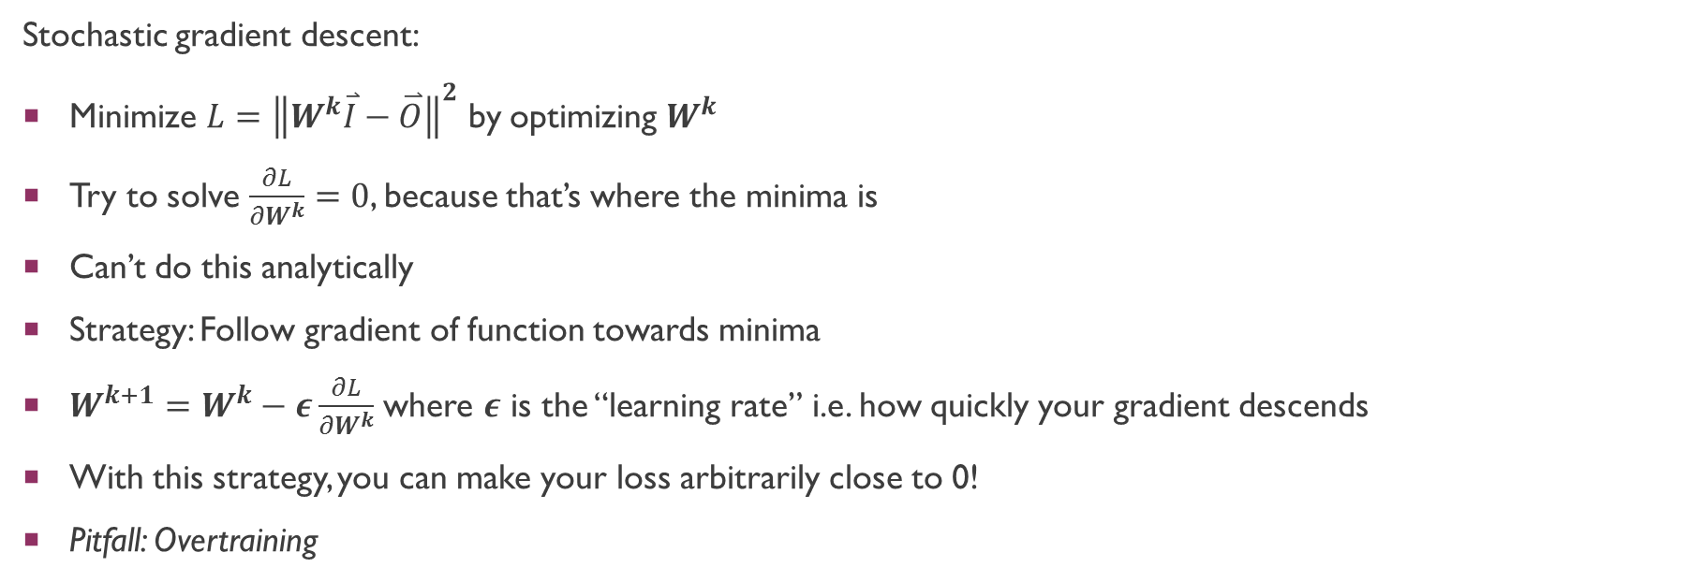
How does Deep Learning Work?
Stochastic gradient descent:
Minimize $L={\left\|W^{k}\overset{⃑}{I}−\overset{⃑}{O}\right\|}^{2}$ by optimizing $W^{k}$
Try to solve $\frac{∂L}{∂W^{k}}=0$, because that’s where the minima is
Can’t do this analytically
Strategy: Follow gradient of function towards minima
$W^{k+1}=W^{k}−ε\frac{∂L}{∂W^{k}}$ where $ε$ is the “learning rate” i.e. how quickly your gradient descends
With this strategy, you can make your loss arbitrarily close to 0!
Pitfall: Overtraining

Slide 26
How does Deep Learning Work?
Before discussing overtraining:
To do machine learning we have to split our data into training and validation sets
Train neural networks using training set
Test how well it works on novel input using validation set
QRI holds the third data set, testing set, which contains predictions for the wells at future dates

Slide 27
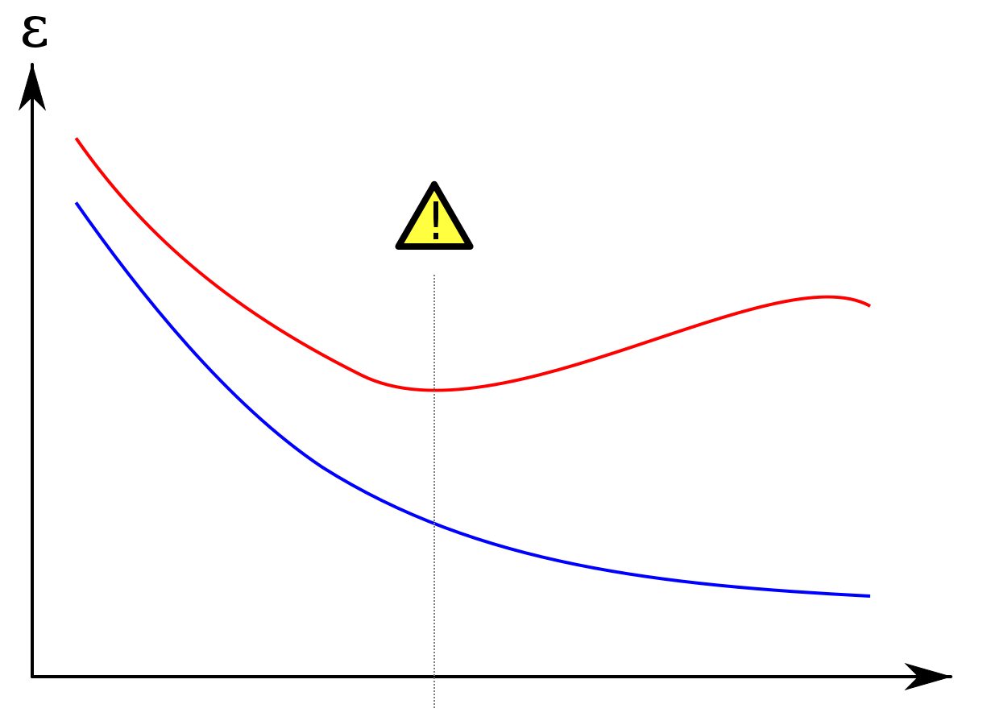
How does Deep Learning Work?
Error
Validation Set
Overtraining: after a certain number of training steps, you continue to get better predictions for your training set but not for your validation set
Training Set
Training Steps

